Slide 1
Confidential Computing
University of Florida, September 2021
Brave New World
Dominic P. Mulligan
Systems Group, Arm Research

Slide 2
What makes a good invited talk for an event like this?
Tell a good tale: some inspiring vision, point of discussion, or controversy
Give a different (industry-oriented) perspective on computer security
Highlight some open research problems
Hopefully not drone on for too long

Slide 3
Confidential Computing
From the beginning

Slide 4
Protecting data in use
Abstractly, data exists in three modes: in transit, at rest, and in use
Cryptographers provided many different prospective tools for protecting data in use:
Homomorphic encryption schemes: compute functions directly on encrypted data without decryption
Secure multi-party computation protocols: compute function over private datasets without sharing
…and so on
Whilst state-of-the-art is improving, in general case not ready for industrial adoption:
Large performance and communication penalties,
Brittle, hard to deploy and configure, hard to compose,
Rely on programmers having to use non-standard tools,
Mathematically terrifying: hard to understand, hard to implement safely

Slide 5
TrustZone and Confidential Computing
Problem: rise of Cloud Computing is making this gap in knowledge an issue
Observation: mobile phone ecosystem encountered similar issues decades ago: how do you protect key system services when malicious users can tamper with the device?
The solution was to introduce Trusted Hardware: specifically Arm TrustZone
Partitions the hardware resources in the device into two worlds: Secure and Non-secure
Use small Trusted OS to manage Trusted Applications executing out of Secure world
Trusted Applications isolated from the Rich OS executing out of the Non-secure world
TrustZone introduced hardware-enabled Confidential Computing, but ecosystem is locked: de facto TrustZone exists to protect manufacturer, mobile phone network, partners

Slide 6
Arm TrustZone
Non-secure
Secure
VM1
App
App
TA
TA
EL0
EL1
OS Kernel
TOS
Secure Partition
Hypervisor
SPM
EL2
Monitor
EL3

Slide 7
Hardware-backed third-party Confidential Computing
Takes ideas from TrustZone and democratise them, an emerging trend:
AMD Secure Encrypted Virtualization (AMD SEV) and various extensions (e.g. AMD SEV-SNP),
Intel Software Guard Extensions (Intel SGX) and Trusted Domain Extensions (Intel TDX),
RISC-V Keystone and Sanctum projects,
Arm’s newly-announced Confidential Computing Architecture (Arm CCA),
Each introduces a hardware-protected domain within which computations take place
Variously called a Secure Enclave, Realm, Trusted Application, Protected Virtual Machine, TEE
I will use the phrasing Isolate to refer to a generic instance
Key requirement: provide confidentiality (and integrity) guarantees to code and data hosted within
Each isolate is protected against a strong attacker:
Can subvert the host, untrusted hypervisor and OS, can spawn malicious isolates,
Most technologies also assume attacker has physical access to device, incorporates DRAM encryption and integrity protection (maybe)

Slide 8
Arm Confidential Compute Architecture (CCA)
Realm
Non-secure
Secure
EL0
RVM1
RVM2
VM1
App
App
TA
TA
App
App
Kernel
Kernel
OS Kernel
TOS
Secure Partition
EL1
Hypervisor
RMM
Hypervisor
SPM
EL2
EL3
Monitor
Root

Slide 9
One last missing piece: Remote Attestation
Earlier mentioned Cloud Computing as a motivation for the rise of Confidential Computing
But… why do you trust an Isolate was spawned by untrusted Cloud host, when requested?
Why trust the code and data transferred to remote machine is the same that’s loaded?
Missing piece is Remote Attestation: cryptographic technique through which a sceptic receives strong evidence that a device was configured in a particular state

Slide 10
One model of attestation
Trusted attestation service
Sceptic
Remote machine
Payload P, with measurement M
Launch isolate, P
Launch Isolate with P loaded
Confirmation
Generate fresh challenge, C
Request token, C
Issue attestation token, T, binding C and measurement, H, other metadata
Relay T
Relay T
Authenticate or reject T
Response
Compare M and H, check C

Slide 11
A (utopian) vision

Slide 12
Stepping back…
Most discussion around Isolates is driven by Cloud Computing use-cases, specifically around moving existing programs and workloads into Isolates
Moving databases into Isolates to try to protect them, and similar
Commercially interesting, will represent the majority of commercial deployments in short term
But… abstractly, Remote Attestation and Isolates give a “beach-head” on another machine
Temporarily, owner is handing over an area of their machine for your private use, protected from their spying or interference
This seems like a bigger deal than protecting existing Cloud workloads!
Question: assuming Isolates are widely deployed, what new things can build with them?

Slide 13
Moving computations around
Question: if Isolates widely deployed does it matter where a computation takes place?
Maybe it makes sense to move the program to where the data is, rather than vice versa?
Maybe computations can become ”mobile”, hopping from machine to machine
Devices with spare capacity could advertise, and computations freely moved onto them
Machines become shared devices, with computing becoming a utility
…or more than it already is with the Cloud!

Slide 14
Fine-grained control and protection of data
Today, once you share a dataset with a third party, you essentially lose control over it
Data is infinitely copyable, and control and possession of data are inextricably linked,
This need not be the case–––something cryptographers have noted: techniques like functional encryption and SMPCs allow sharing of data, whilst keeping control over it by limiting how it’s used
But functional encryption and SMPCs are largely impractical…
Imagine world where data is encrypted when at rest, only decrypted inside an Isolate
Data moves between Isolates for processing, Remote Attestation used to authenticate
Data is bundled with declarative policies, describing permitted ways in which can be used

Slide 15
Realizing this…
If computations were to hop from Isolate to Isolate, device to device, we’d need
Some way of advertising a device’s capabilities,
Some way of deciding scheduling (e.g. deciding that the potential speed-up of moving to a new device is worth stopping the computation and the transmission cost),
Some uniform programming model across devices of different kinds,
Various protocols for Remote Attestation, provisioning, querying computation state, etc.
Barring some, similar requirements for exhibiting control over distributed data:
Some declarative policy describing permissible uses of data,
A trusted runtime, or other component, that enforces those policies

Slide 16
Veracruz: privacy-preserving collaborative computation
https://github.com/veracruz-project/veracruz

Slide 17
The Veracruz framework
A framework for defining flexible and efficient multi-party computations
Veracruz aims to support common use-cases for advanced cryptographic techniques
Techniques like homomorphic encryption, secure-multiparty computations, and similar
Unlike those techniques, we aim to be:
Efficient: Be fast enough to execute ”interesting” programs,
Familiar: Allow programmers to use familiar programming languages and tools,
General: Seamlessly support a large class of multi-party computations,
Reusable: Provide a single framework supporting a wide-range of privacy-preserving computations without requiring significant reconfiguration for each task
In common with those techniques, we aim to provide a strong security/privacy guarantee

Slide 18

Veracruz from 50,000ft
Program and data are provisioned securely into Veracruz, running on a host, which computes a result by applying the program to the data.
To maintain secrecy we need to control the expressivity of the program P, and the capabilities of its environment, which computes the result.
Data₁
Data₂
Data_{N}
Veracruz
A policy details the roles and identities of all involved in the computation and describes who can retrieve the result.
The program, which may originate from an agent distinct from those providing the data inputs. In Veracruz, we use WebAssembly (WASM) as our executable.
The data inputs to Veracruz. Note that these can originate from different agents who are mutually distrusting.
Result
P(Data₁, Data₂, …, Data_{N})
Program
P
Global policy

Slide 19



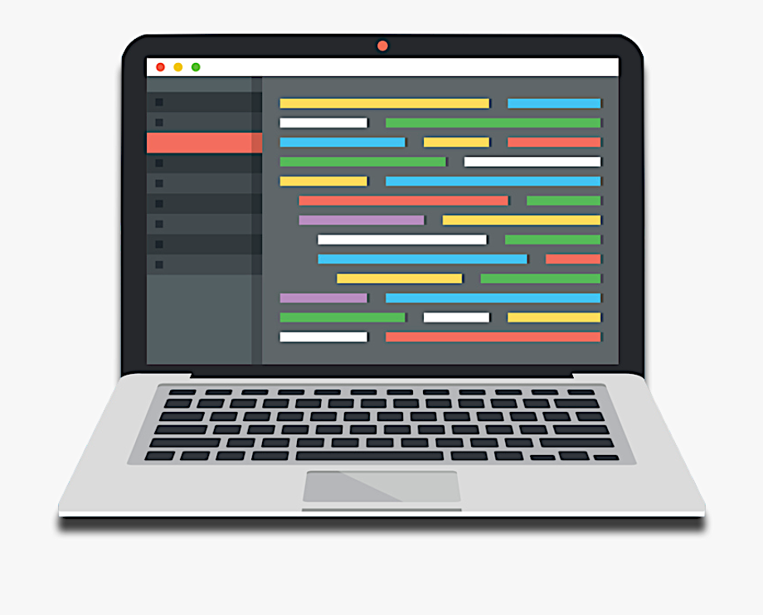
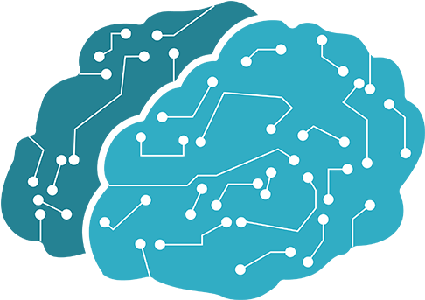
Use-case: privacy-preserving machine learning
Veracruz
Global policy
Machine Learning Model

Slide 20
Use-case: privacy-preserving set-sum computation
A45B3201
B8920345
45398A21
…
Veracruz
Internet advertising platform
Client
A45B3201: £4.99
E3332110: £34.23
01224573: £17.50
…
Global policy
Σ referred customer spend

Slide 21
…and many more potential use-cases
Privacy-preserving surveys/auctions/elections,
Privacy-preserving distributed compute: map-reduce/grid computing a la SETI@home,
Private search/fuzzy matching,
Provenance tracking for data,
Verifiable computation,
N-way secret sharing,
Fair exchange of documents,
IP protection,
Zero-knowledge proof of knowledge,
Delegating computations from weak devices to untrusted servers,
…ad infinitum

Slide 22
Abstracting over isolates
Veracruz supports multiple different isolation technologies at present:
Arm TrustZone trusted applications, and Arm CCA Realms (internally),
Intel SGX secure enclaves,
AWS Nitro Enclaves,
The high-assurance seL4 microkernel, and plain Linux processes…
…representing different points on a continuum of paranoia
Veracruz provides abstractions over isolate technologies, with:
A single, portable programming model based on WebAssembly and WASI
A unified attestation mechanism, using PKI

Slide 23
Research opportunities

Slide 24
Elephant in the room
Existing systems have been shown susceptible to a wide-range of side-channel attacks
Many shared structures, including caches, page tables, branch predictors, have been targeted
Attacker now assumed to have access to key system capabilities previously gated by a trusted OS
Isolates taken a battering in the press over vulnerabilities related to side-channels
Having acknowledged that!
Many attacks explicitly outside the Threat Model of attacked implementations
Vulnerability doesn’t make Isolates useless: many use-cases where side-channels are manageable,
Forcing attackers to use (impractical) attacks to steal data improvement on status quo
Obsession allowing perfect be enemy of good, impediment to pragmatic improvement in data security
Nevertheless: we need better support for writing side-channel resistant software
Mainstream programming languages have no support for this: compilers actively fight programmer
Potential for hardware and software to co-operate: marked regions of sensitive code where caches are regularly flushed, etc.

Slide 25
Mass, decentralized attestation
Many current attestation models make use of a trusted attestation service
Typically setup and hosted by hardware manufacturer,
Used to authenticate or reject attestation tokens issued by an Isolate
Note that this attestation service essentially has visibility over every Isolate launch
You may even need to pay for an attestation token authentication, too…
In peer-to-peer networks attestation service is a single point-of-failure (and vulnerability!)
Are there more decentralized attestation models? Models that accommodate huge numbers of Isolates being launched?
We have some ideas, may be an interesting student project to investigate…

Slide 26
Policies, and scheduling for fine-grained control over data
Casting mind back to vision of data moving from Isolate to Isolate, mentioned policies
What do these policies look like? Moreover, how can they be enforced?
Could be pretty coarse-grained: data tagged with label A can move from Isolate I to J
Alternatively, could be pretty fine-grained: data tagged with label A can move from Isolate I to J provided J satisfies some property ɸ
Consider building private Grid Computing/Map-Reduce framework on top of Veracruz
Veracruz supports multiple Isolation mechanisms, each with different Threat and Trust Models
Computations need not always be scheduled in e.g. Arm CCA Realms, or Intel SGX enclaves
Sometimes, ordinary Linux processes will suffice, maybe computations can be factored
How to describe this, so that computations can be scheduled on appropriate Isolation technologies?

Slide 27
Conclusions

Slide 28
Some of our other related activities
Focussed here on Veracruz, a project I’m most familiar with, but we are also:
IceCap: pragmatic isolation techniques for devices without hardware-backed Isolation
Long tail of legacy Arm devices that will continue to exist for decades to come
Can we introduce some pragmatic Isolate-like technology there?
IceCap uses high-assurance seL4 hypervisor to provide (software/MMU) Isolates for protected VMs
See: https://gitlab.com/arm-research/security/icecap/icecap
Investigating Ambient Computing:
How should a device advertise its spare computing capability?
How should we decide to move a computation from one device to another?
Investigating hardware acceleration for Fully Homomorphic Encryption, and efficient implementations of emerging PQC algorithms on low-powered Arm hardware

Slide 29
Wrapping it up…
Confidential Computing is an emerging trend within industry, driven by Cloud deployments
Remote Attestation and Strong Isolation have potential interesting uses beyond protecting existing Cloud workloads: taken as primitive, what things can build with them?
Isolates can enable mobile computations, exhibit fine control over data in systems
Veracruz exploring how these visions can be realized, builds upon technology like Arm CCA
Lots of potential for further research needed to deliver on this vision

